Slide 1
DNA and Chromosomes
G. Swapna
Lecturer in Botany

Slide 2
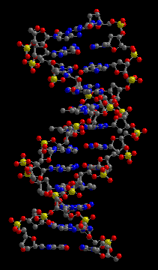
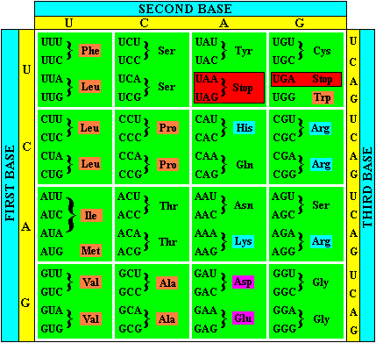
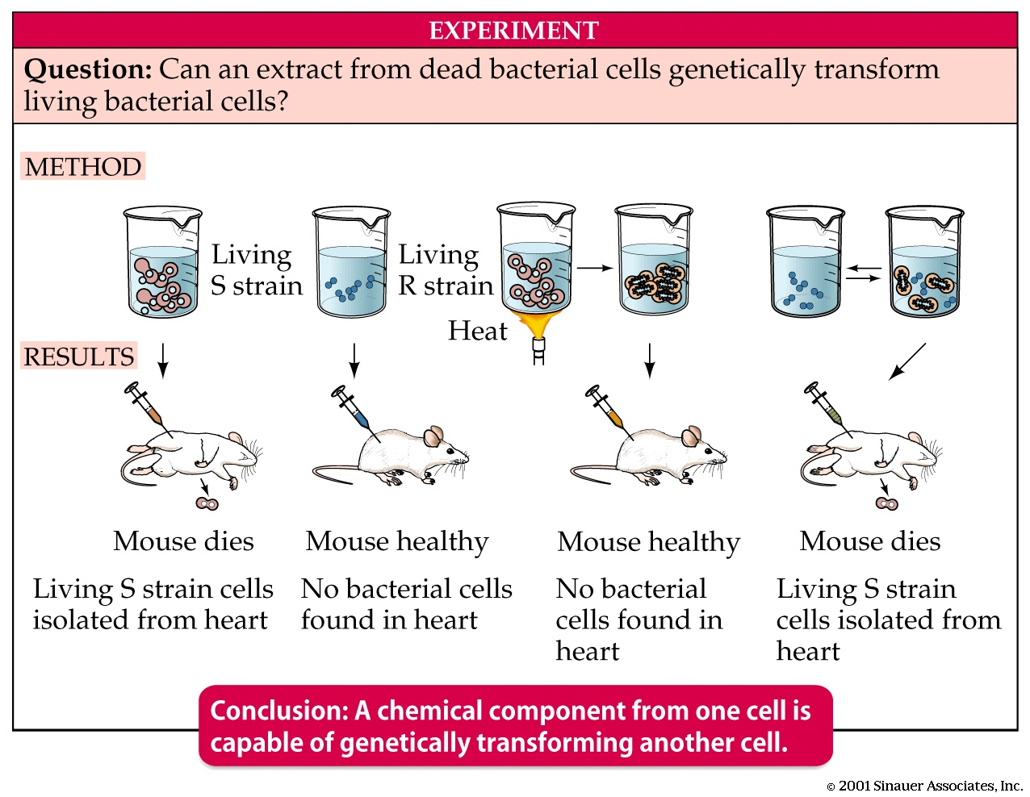
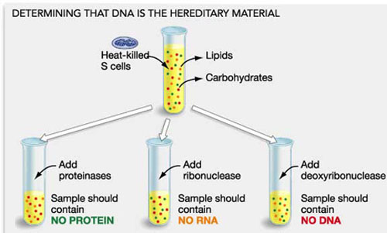
The Structure and Function of DNA
Landmark Discoveries
1940’s Studies with Fungi reveal Genetic info = instructions for making proteins
1940’s Discovery of DNA is genetic info
1953 Structure of DNA Resolved
1964 Genetic Code revealed

Slide 3
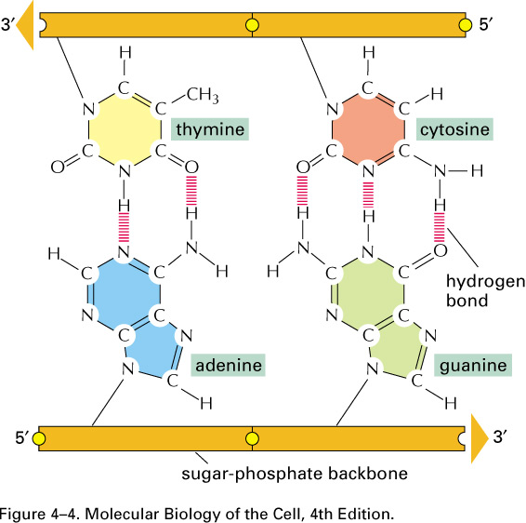
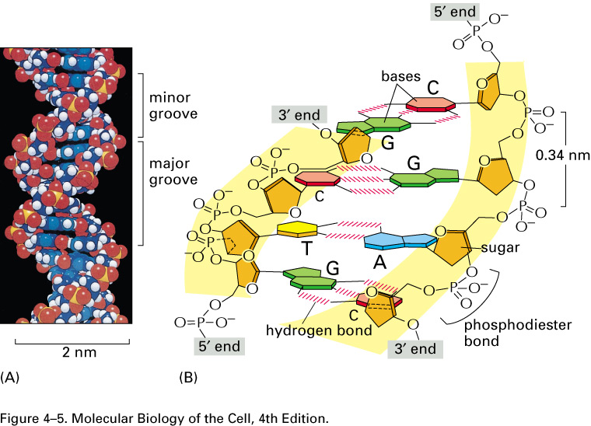
The Structure and Function of DNA
Structural Features of DNA
2 Complementary chains of nucleotides
A, T, G, Cs held by H-bonds
Nucelotides linked by sugar-phosphate bonds
Deoxyribose sugar
Polar 5’ phosphate linked to 3’ OH
Complementary base pairing
Antiparallel

Slide 4
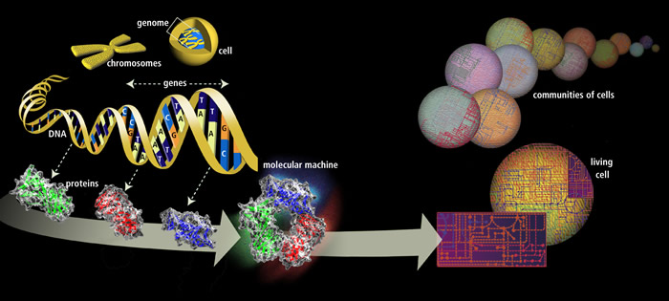
The Structure and Function of DNA
Structure of DNA Provides Mechanism for Heredity:
Genes carry biological info that must be copied accurately for transmission
to next generation ea time cell divides
DNA encodes info through order or sequence of nucleotides
Organisms differ because of respective DNA which encodes different
biological messages

Slide 5
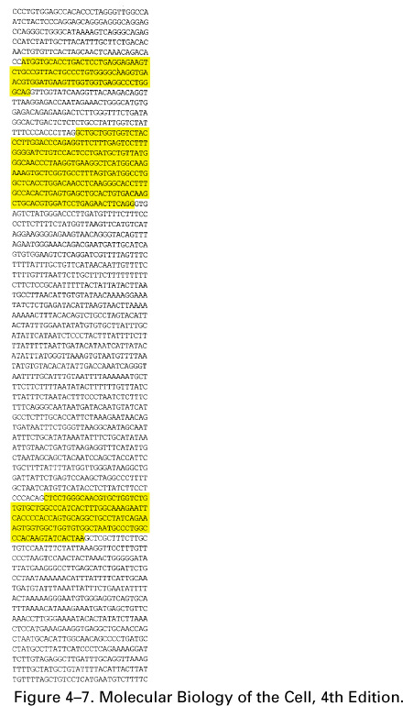
The Structure and Function of DNA
From DNA to Proteins
Properties of proteins governed by 3d structure
Sequence of nucleotides in gene must determine sequence of aa in protein
Genetic code not obvious from DNA structure

Slide 6
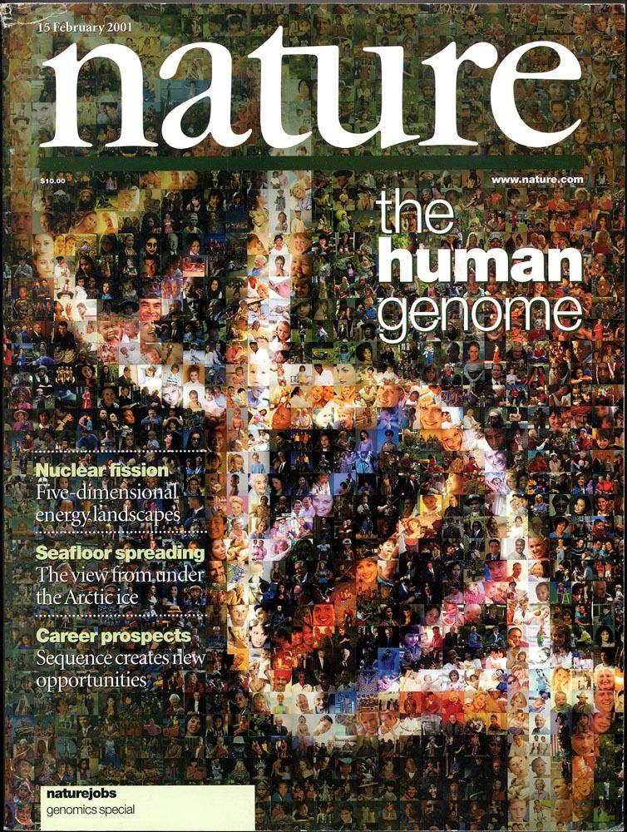
The Structure and Function of DNA
Genome
Complete set of info in organisms DNA
Human genome: ~50,000 distinct proteins

Slide 7
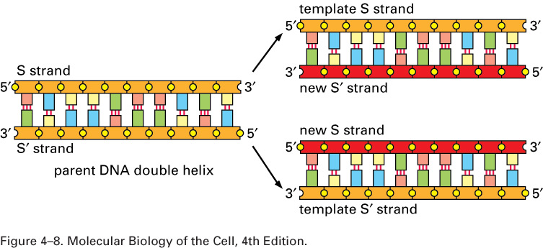
The Structure and Function of DNA
How is the Genome copied at ea cell division?
  ea DNA strand can act as a template
  template used as mold for synthesis of new complementary strand

Slide 8
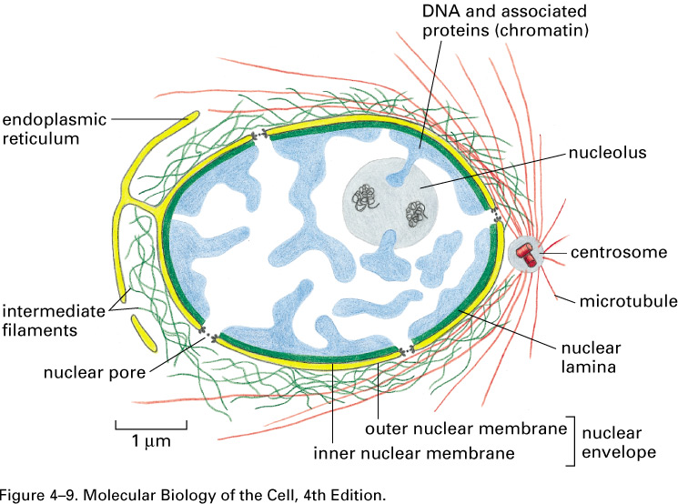
The Structure and Function of DNA
DNA is housed in the nucleus
comprises 10% cell
Delimited by nuclear envelope with pores
Envelope contiguous w/ER
Mechanically supported by intermediate filaments of nuclear lamina and network of intermediate filaments surrounding outer membrane
Protects and compartmentalizes

Slide 9
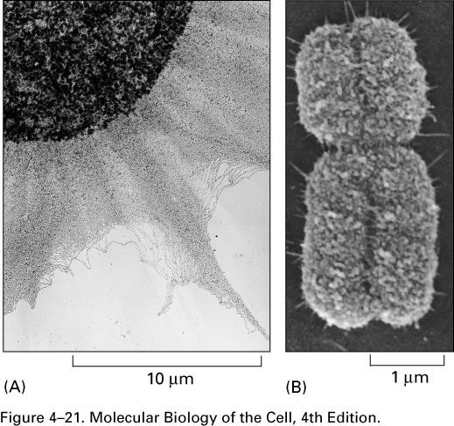
Packaging of DNA into Chromosomes
Challenges of Packaging DNA
How to get 2 meters of DNA into nucleus of 6 um
Packaging accomplished w/ help of proteins
Must be compacted in manner that still allows for it to be accessed by enzymes that govern replication, transcription, and repair

Slide 10
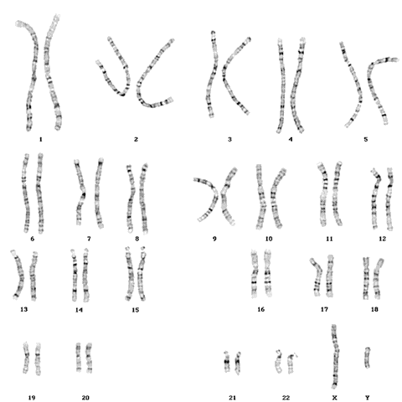
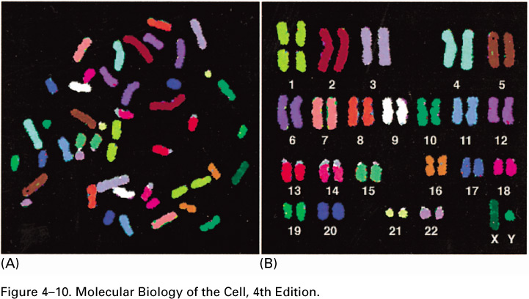
Packaging of DNA into Chromosomes
Eucaryotic DNA is packaged into a set of chromosomes
DNA divided into set of chromosomes
Chromosome= single DNA molecule and proteins associated with it

Slide 11
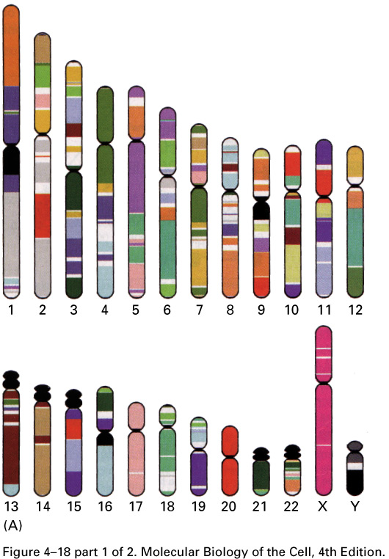
Packaging of DNA into Chromosomes
Human Chromosomes
Human DNA 3.2 x 10⁹ bases distributed over 24 chromosomes
Each human cell contains 46 chromosomes
22 homologous chromosomes
2 sex chromosomes (XX in females;
XY in males)

Slide 12
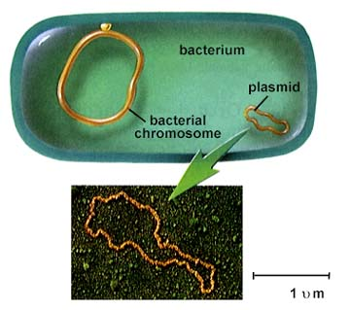
Packaging of DNA into Chromosomes
Bacteria have single circular DNA chromosome
  Proteins pack DNA into compact structure
  Proteins associated w/ processes of transcription, repair, replication

Slide 13
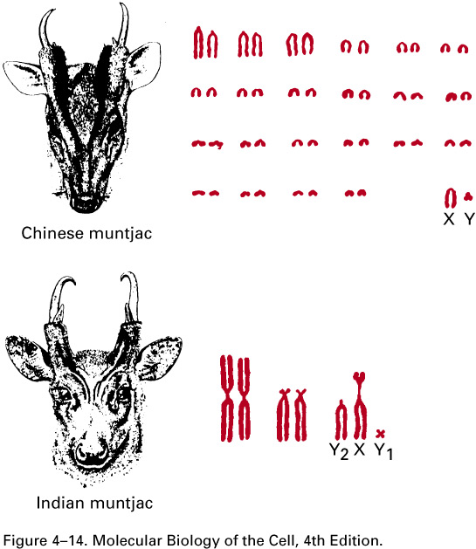
Packaging of DNA into Chromosomes
Chromosomes Contain Long Strings of Genes
Most impt function of chromosomes= carry genes
Gene= segment of DNA containing info for making protein (not true for RNA molec that perform diverse functions)
Correlation btwn complexity of organism and gene number
Generally, more complex organisms have larger genomes, but not always
No relationship btwn chromosome number and complexity or genome size

Slide 14
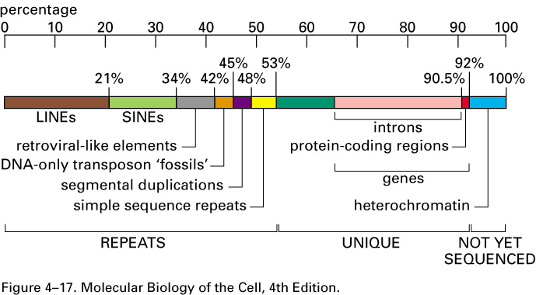
Packing of DNA into Chromosomes
Most Striking Features of Human Genome
~30,000 gene sequences
Vast amount of non-coding DNA
Lg number of transposable elements
Lg average gene size 27,000 bp when only 1300 required to
encode avg size protein
Critical info seems to be in alarming state of disarray!

Slide 15
Packing of DNA into Chromosomes
Comparing DNA from Related Organisms
Gene Prediction difficult with all the “junk DNA”
Comparative DNA sequencing studies highlights important regions in genome
Conserved synteny= when gene order and content is conserved

Slide 16
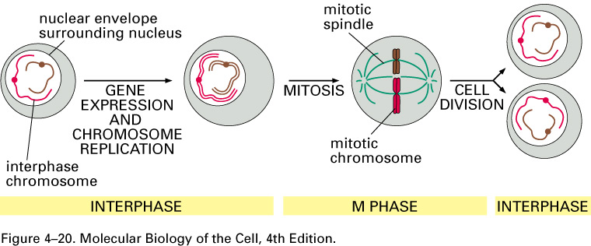
Packing of DNA into Chromosomes
Chromosomes Exist in Different States Throughout Life of Cell
Mitotic chromosomes= highly condensed chromosomes of dividing cell
During interphase chromosomes present as extended thin threads in nucleus, not readily visible

Slide 17
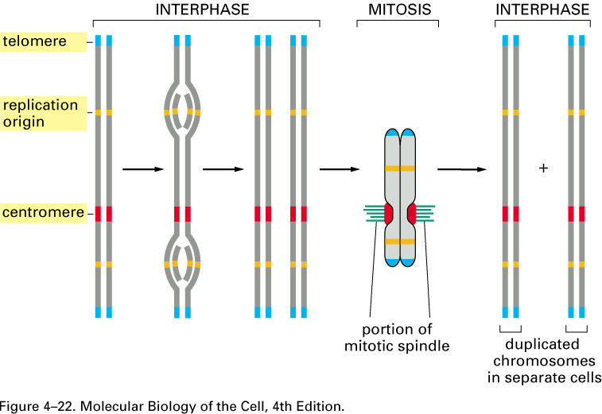
Packing of DNA into Chromosomes
Essential Features of a Linear Chromosome:
Centromere
(2) Telomeres
Replication Origins

Slide 18
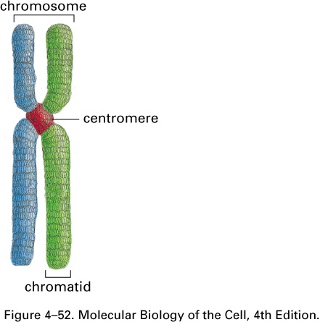
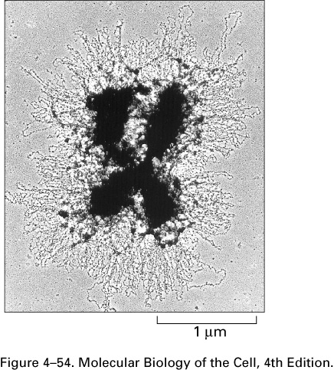
Packing of DNA into Chromosomes
DNA is highly condensed in chromosomes
Compression of DNA performed by proteins
human chromosome 22
48 million bp
extended 1.5 cm; packed in space 0.2 um
10,000X compaction ratio
DNA of interphase chromo less dense but overall compaction ratio still ~1000X
Chromosome structure is dynamic

Slide 19
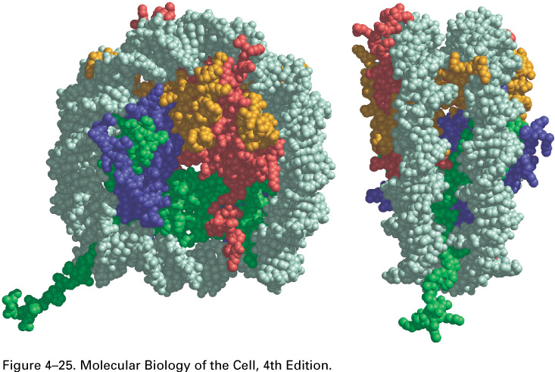
Packing of DNA into Chromosomes
Chromatin= nuclear DNA plus all the proteins bound to it
Two classes of proteins bind to DNA to form chromosome
1. histones
2. nonhistone

Slide 20
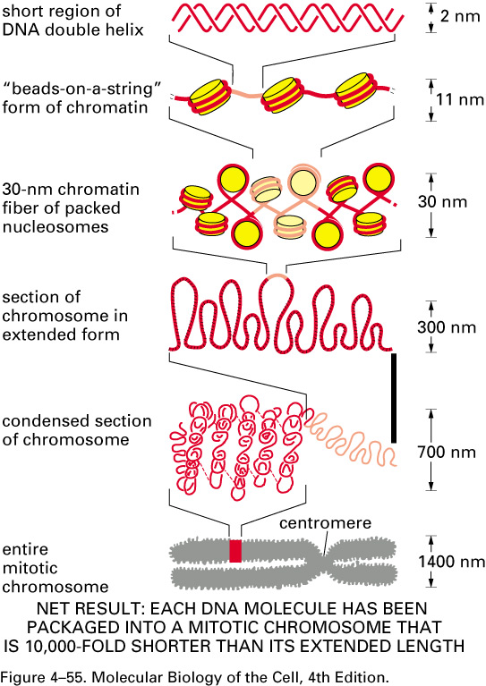
Packing of DNA into Chromosomes
5 levels of Chromosomal Packaging

Slide 21
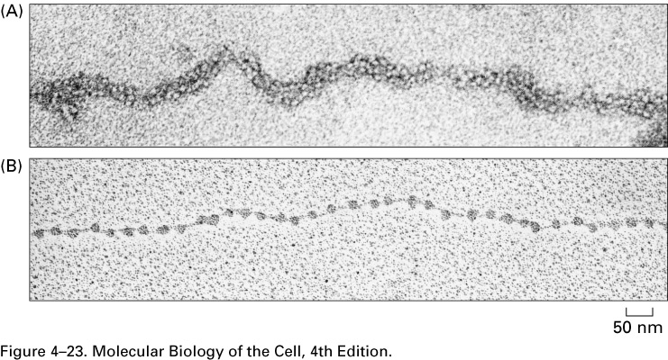
Packing of DNA into Chromosomes
Nucleosomes as Basic Unit of Eucaryotic Chromosome Structure
Discovered 1974
DNA wrapped around octameric core of histone proteins
Repeat every 200 bp
Linker DNA btwn nucleosomes ~80 bp
3x level of compaction
human DNA 6.4 x 10⁹ bp w/ 30 million nucleosomes

Slide 22
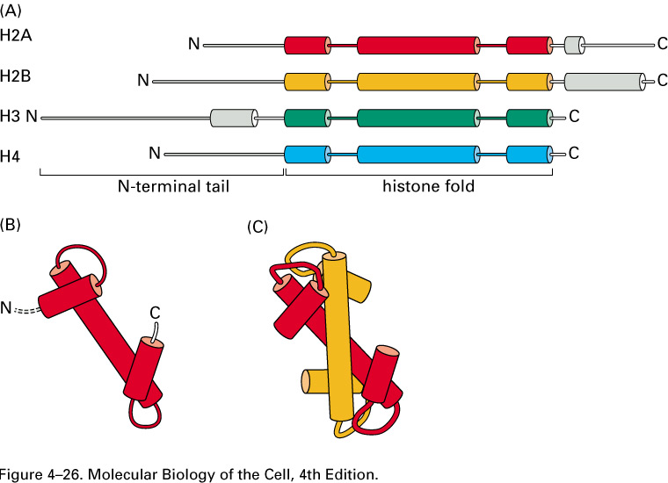
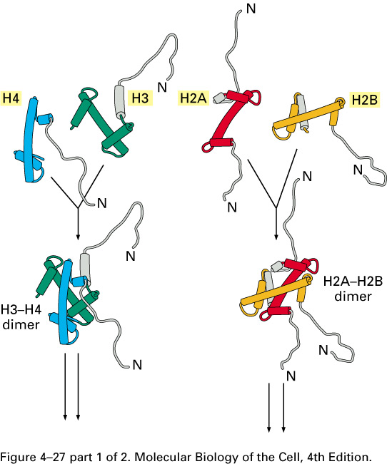
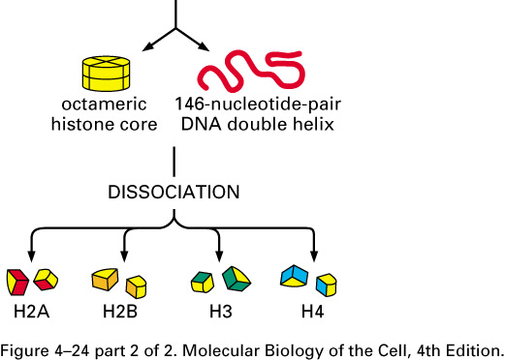
Packing of DNA into Chromosomes
Characteristics of Histone Proteins
60 million/cell
Histone mass of chromosome = DNA mass
Responsible for packaging DNA into nucleosomes
4 different types: H2A, H2B, H3, H4
Highly conserved, 102-135 aa
Rich in lys and arg
Long N-terminal tail subjected to covalent modification
Specialized variant histones

Slide 23
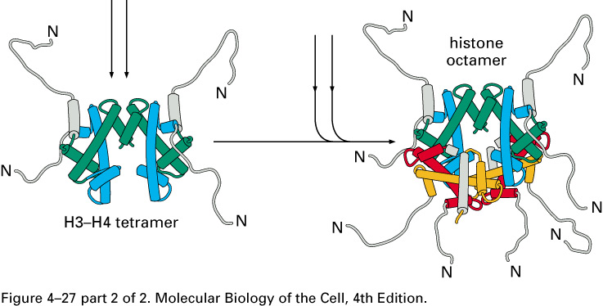
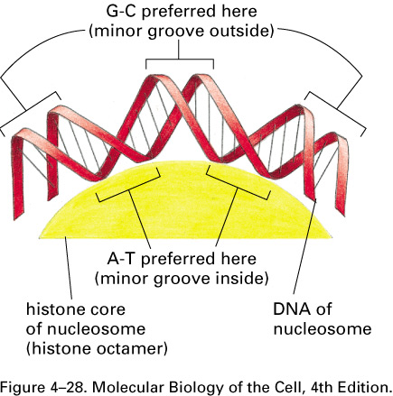
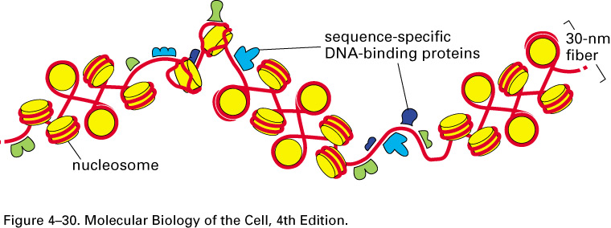
Packing of DNA into Chromosomes
Histones as basic unit of nucleosomes
Interface btwn DNA and histone extensive; ~142 H-bonds
Hydrophobic and salt linkages also involved in DNA:histone
Covalent modifications of N-terminal tail of histones controls aspects of chromatin structure
Positioning of nucleosomes determined by DNA flexibility and other DNA bound proteins
  short AT rich regions impart flexibility to DNA
  bound proteins can facilitate formation of nucleosomes or present obstacle
Arrangement of nucleosomes dynamic

Slide 24
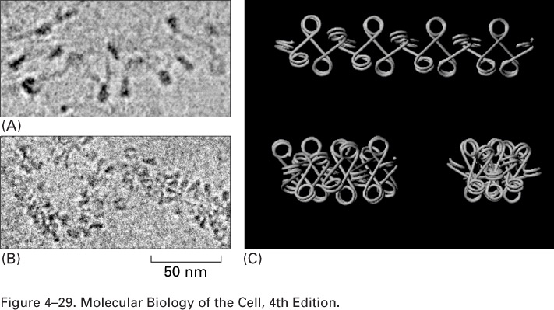
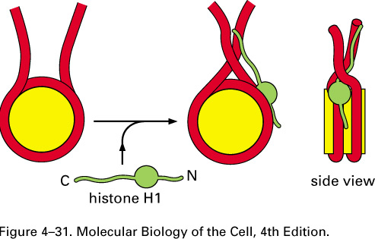
Packing of DNA into Chromosomes
30 nm Chromatin Fiber
Nucleosomes packed into 30 nm fiber
Fiber formation facilitated by H1 histone (histone larger than core histones) thot to link core histones together
Tails of core histones may attach one nucleosomes to another
Humans 1 cm in length spans nucleus 100X

Slide 25
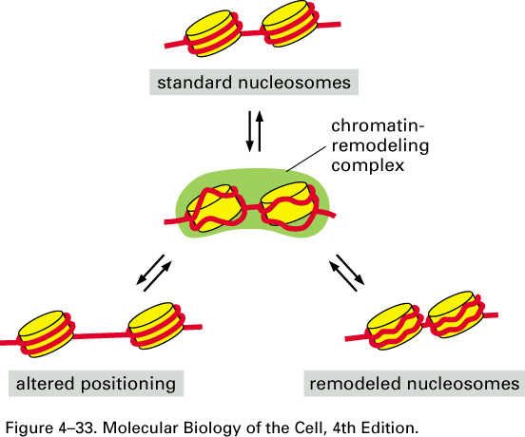
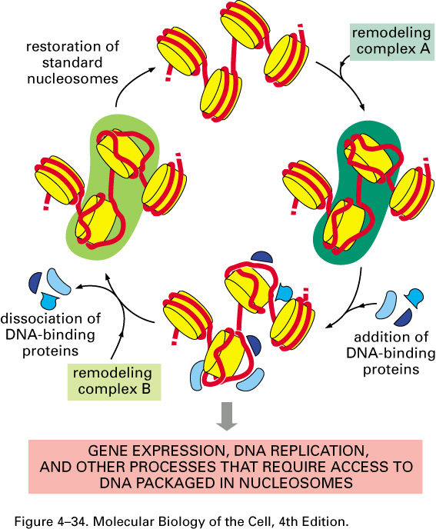
Packing of DNA into Chromosomes
ATP Driven Remodeling Complexes
Temporarily change nucleosome structure
Complex of > 10 subunits
Some provide acess
Others reform nucleosomes or even transfer nucleosomes
Regulation of complexes may be afforded by phosphorylation/dephosphorylation

Slide 26
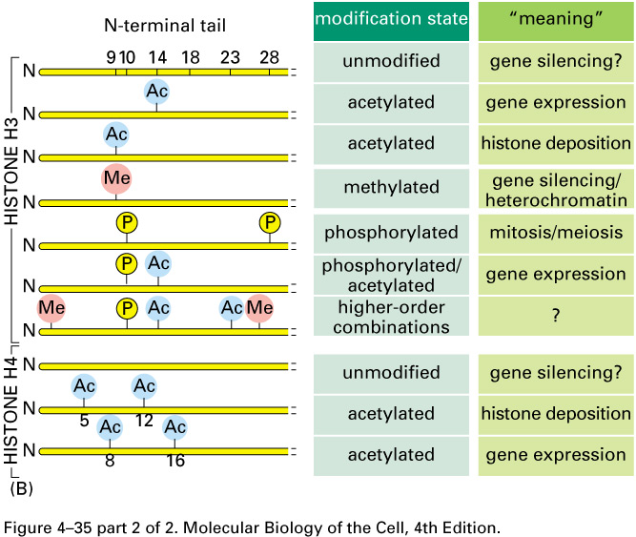
Packing of DNA into Chromosomes
Covalent Modification of Histone Tails
Affect stability of nucleosome
Attract specific proteins
HATs histone acetyl transferases add acetyl grps to lys
HDACs histone deacetylases take acetyl grps off
Methylation of lys
Phosphorylation of ser

Slide 27
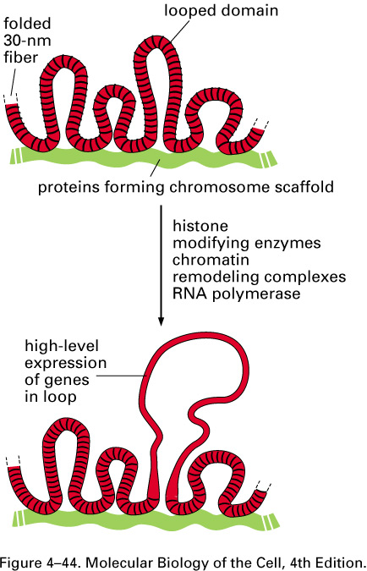
Packing of DNA into Chromosomes
Loops and Coils
Lg loops emanate from linear chromo axis
Loops always contains same DNA
Genes in loops are actively expressed
DNA not in loops condensed in chromomeres on axis
Fiber converted to loop by histone modifying enzymes, remodeling complexes and other proteins required for gene expression
Ea loop is independent functional domain of chromatin structure

Slide 28
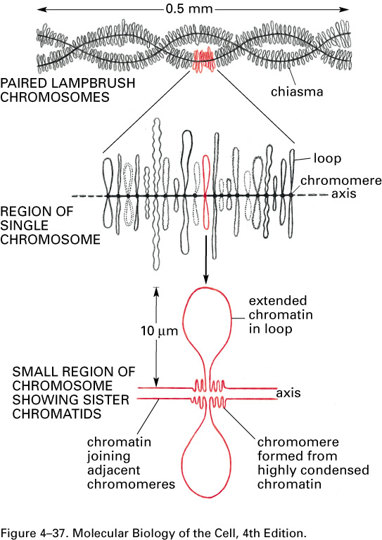
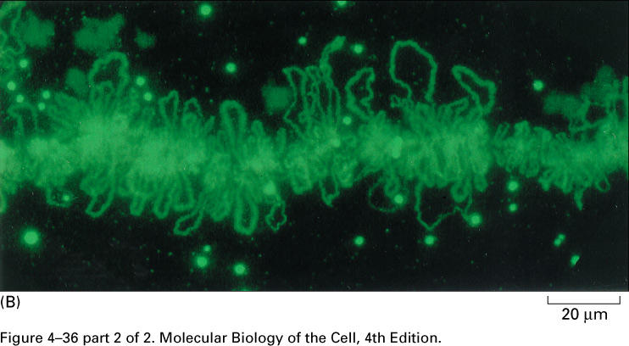
Packing of DNA into Chromosomes
Lampbrush Chromosomes
Meiotically paired chromo growing amph. oocytes

Slide 29
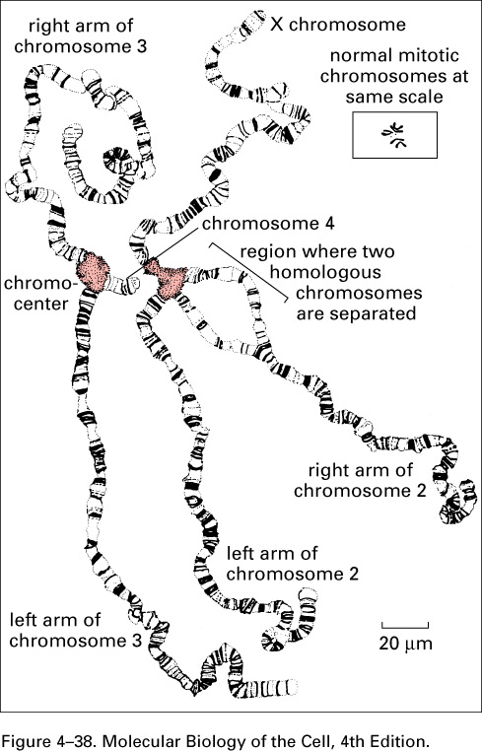
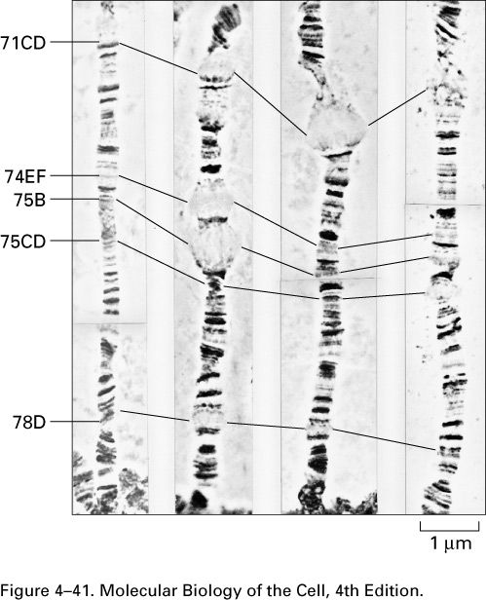
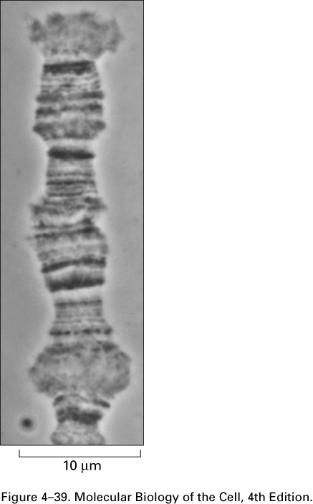
Packing of DNA into Chromosomes
Polytene Chromosomes of Drosophlia
1024 identical DNA strands line up (10 cycles of DNA syn w/out cell division
Alternating bands (95%) and interbands (5%); dynamic
Interbands represent genes being actively transcribed

Slide 30
Packaging of DNA into Chromosomes
Features of Interphase Chromosomes
30 nm fiber = default structure
Histone modifying enzymes, remodeling complexes, and other proteins resp. for converting fiber into extended loop form when gene expressed
Ea loop = independent functional domain of chromatin structure
Chromosomes occupy distinct place in nucleus

Slide 31
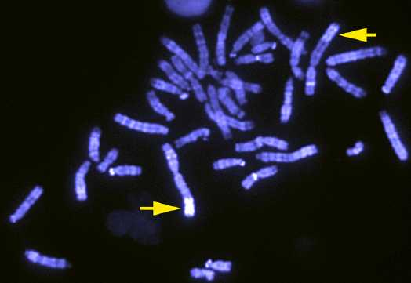
Packaging of DNA into Chromosomes
Heterochromatin
diff types of condensed chromatin w/ distinct features and roles
Found in variety of organisms
Represents 10% of chromosome
Highly organized, resistant to gene expression
Resp for function of telomeres, centromeres, and may protect genome from transposable elements

Slide 32
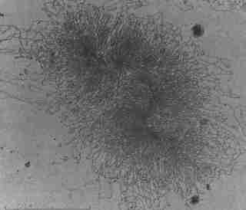
Packaging of DNA into Chromosomes
Euchromatin
Less condensed
Composed of all types of chromatin structures- 30 nm fibers, loops, etc
90% of chromatin
transcribable

Slide 33
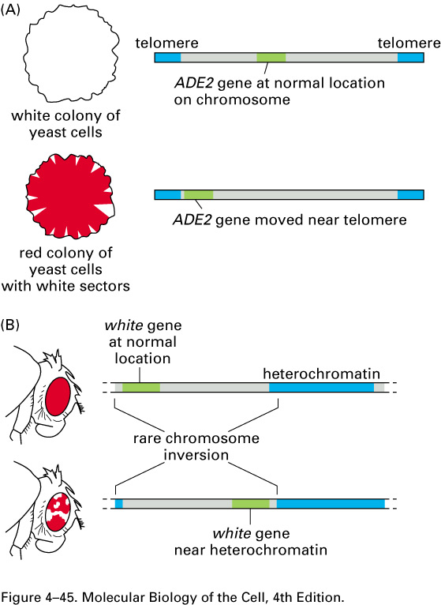
Packaging of DNA into Chromosomes
Gene Silencing and Position Effects
Genes relocated to region of heterochromatin are silenced
Position effects = when activity of gene depends on position along chromosome
Position effect variegation = molted expression
pattern results from patches of cells in which a silenced gene has become activated or when selected regions randomly packaged to heterochromatin and silenced== both then are stabily inherited

Slide 34
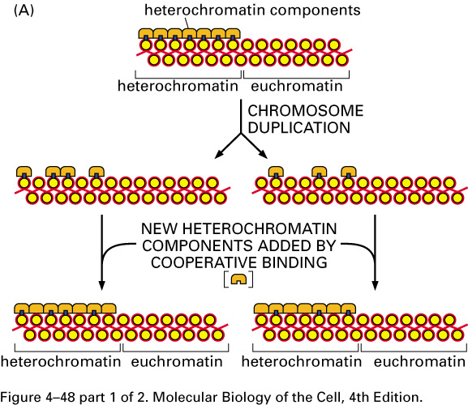
Packaging of DNA into Chromosomes
Position Effect Variegation demonstrates
Heterochromatin is dynamic and can spread into region and later retract
Whether heterochromatin or euchromatin can be inherited

Slide 35
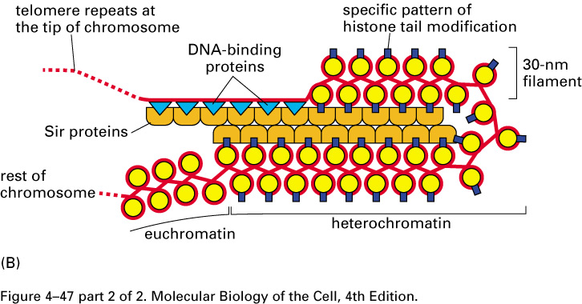
Packaging of DNA into Chromosomes
Special Form of Heterochromatin at Chromosomal Ends
Chromatin region extending 5,000 bp from chromo ends resistant to gene expression
Many diff proteins required for special folding
Mutations in silent information regulator proteins (SIR) prevent silencing of genes near telomeres
Cooperative binding of SIRs occurs to facilitate modifications

Slide 36
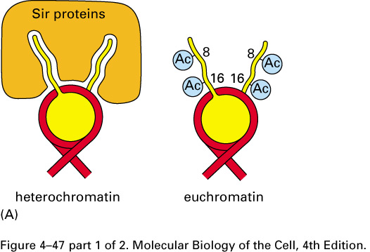
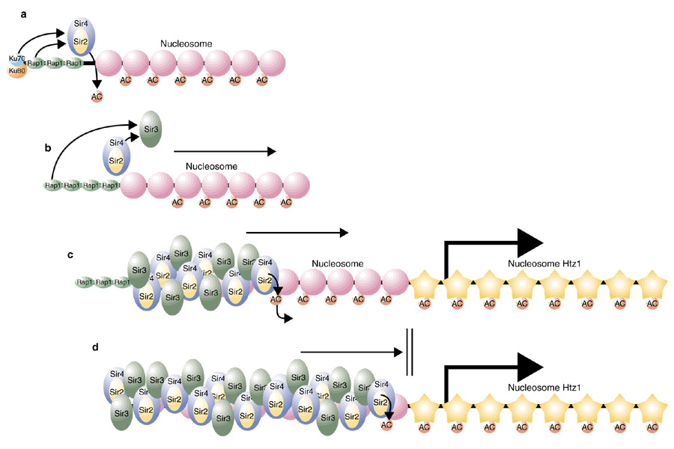
Packaging of DNA into Chromosomes
SIRs
SIRs types
1. recognizes underacetylated N-terminal tails of selected histones
2. SIR2 = conserved histone deacetylase- deacetylation of histone tails thot to allow tighter packaging of nucleosomes that are less susceptible to remodeling complexes
SIR2 requires NAD+ cofactor; NAD+ levels fluctuate w/ nutritional status of cell increasing under nutritional deprivation

Slide 37
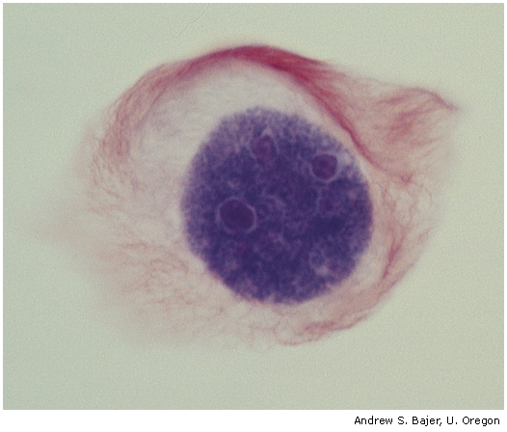



Packaging of DNA into Chromosomes
Mitotic Chromosomes= Chromatin in Most Condensed Form

Slide 38

Packaging of DNA into Chromosomes
Mitotic Chromosomes= Chromatin in Most Condensed Form
10x smaller than interphase chromosomes
Function
1. compaction protects fragile DNA from breaking
2. allows sister chromatids to be easily separated by mitotic apparatus
Condensin proteins use ATP to drive coiling of interphase chromosomes
Characteristic pattern of condensed AT rich regions and less condensed CG rich regions- geisma staining

Slide 39
Thank you

